Slide 1

Asset
Products
Nerea Ortega
Bodian Li

Slide 2


Balance Sheet
of a Bank

Slide 3


Introduction
Balance Sheet of a Bank
Asset Products in a Bank

Slide 4
A Bank’s Balance Sheet
Example
Assets
Liabilities
Cash and Reserves $9,000
Earning Assets
Loans $124,000
Securities $53,000
Non-Earning Assets $14,000
Deposits $145,000
Borrowings $40,000
Shareholder’s Equity $13,000
Retained Earnings $2,000
Total Assets $200,000
Total Liabilities $200,000

Slide 5
Asset Products
in a Bank

Slide 6

Asset Product
Guideline
Cash and Reserves
Earning assets
Loans
Securities
Bonds
Securitizations
REPOs
Derivatives
Non – earning assets (buildings, equipment, furniture…)

Slide 7

Asset Product
Cash
Vault cash
Paper currency and coins held in the bank vaults
Deposits at Central Bank
Deposits accounts that the commercial bank has at the central bank
Minimum and Excess reserves
Required Reserves
Minimum amount that commercial banks are required to hold by the central bank. They are calculated based on the bank’s deposit liabilities.
Excess Reserves
Reserves that the bank has in excess of the minimum requirement. The commercial bank earn interest on the excess reserves.

Slide 8
Asset Product
Loans and Lines of credit
What is the difference between a loan and a line of credit?
In a loan the borrower has access to the full amount loaned once, and makes principal and interest payments on that amount until the debt is paid off.
In a Credit Line, the borrower can withdraw funds up to a pre-set limit, and makes principal and interest payments only on the withdrawn amount, like a credit card. They are usually unsecured loans.
Revolving vs Non-Revolving
A revolving line of credit: It allows borrowers to spend the money, repay it, and spend it again in a virtually never-ending, revolving cycle. E.g, Credit cards.
A Non-revolving line of credit: The pool of available credit does not replenish after payments are made. Once you pay off the line of credit in full, the account is closed and cannot be used again.

Slide 9
Asset Product
Loans
Retail Loans
Mortgage
Mortgages are collateralized loans distributed by banks to allow consumers to buy homes they can’t pay for upfront. A mortgage is tied to your home, meaning you risk foreclosure if you fall behind on payments.
Auto Loans
Like mortgages, auto loans are tied to your property. They can help you afford a vehicle, but you risk losing the car if you miss payments.
Student Loans
Student loans are offered to college students and their families to help cover the cost of higher education.
Home Equity Loans
If you have equity in your home – the house is worth more than you owe on it – you can use that equity to help pay for big projects.
Commercial Loans
Commercial Real Estate
Mortgages given to companies and businesses to buy commercial property
Development loans
Loans given to construction
Trade Finance
Financial instruments given to companies to facilitate the international trade and commerce
Leasing
A lease is a term rental agreement for the use of specific equipment.

Slide 10
Asset Product
Loans
Secured vs Unsecured loans
Unsecured Loan → It has no collateral backing the loan, that is, there is no security tied up to the loan. It entails higher credit risk and as a result, the bank charges higher interest rates.
Secured Loan → Like mortgages or car loans, the borrower puts up an asset as a collateral of the loan. If the borrower fails to payback the loan, the bank has the right to acquire ownership of the collateral asset. Interest rates are lower for secured loans since they carry less risk for the bank.
Guaranteed Loans
In a guaranteed loan a third party (guarantor) assumes the debt obligation if the borrower defaults on loan payments. Most common are:
Guaranteed mortgage
Federal student loans

Slide 11
Asset Product
Bonds
What is a bond?
A Bond is a fixed income security issued by governments and corporations to fund their projects and operations. An investor lends money to a borrower in exchange for periodic coupon payments and the principal’s repayment at maturity.
Features of a Bond
Coupon Rate
Is the rate of interest the bond issuer will pay on the face value of the bond, expressed as a percentage.
Face Value
It is the value of the bond at maturity. This is the amount based on which coupon payments are calculated.
Coupon
Yield
Is the return an investor makes on a bond. It is a function of the bond’s price and the coupon payments
Maturity
Date on which the bond matures and the issuer has to pay the face value to the bondholder

Slide 12
Asset Product
Bonds
Bond Categories:
Corporate Bond
Bonds issued by companies. Corporations issue bonds as an alternative to bank loans
Government Bonds
Treasury Bill
Short term instruments, maturity less than a year
Treasury Notes
Maturity between 1 and 10 years
Treasury Bonds
Maturity between 10 years to 30 years.
Primary Market
Coupon Payments + Face Value at maturity
INVESTOR
(BONDHOLDER)
ISSUER
(GOVERNMENT / CORPORATION)
Money
(Bond Price)
Secondary Market
Coupon Payments + Face Value at maturity
INVESTOR 2
(BUYER)
ISSUER
(GOVERNMENT / CORPORATION)
INVESTOR 1
(SELLER)
Money
(Bond Price)

Slide 13
Asset Product
Bonds
Capital Stack and seniority ranking
In case of bankruptcy or sale of the company, the order in which the security holders are repaid is called ‘seniority’
Equity
Subordinated Debt
Senior Debt
PRIORITY OF PAYMENT
(In case of default)
HIGHER RISK

Slide 14
Asset Product
Securitizations
What is securitization?
It is a procedure through which a marketable financial instrument is designed by pooling various financial assets into a package, which is then sold to investors. This allows the originator of the assets to free up capital for other investments.
Mortgage-Backed Securities
Most common of securitization are Mortgage-Backed Securities (MBS). Groups of mortgages are combined into a large portfolio and then divided into pieces based on the risk of default of each mortgage, and sold to investors.
Government-Sponsored mortgage companies
These agencies buy mortgage loans from banks and create and issue securities off them, that are then sold to investors (including banks). These securities carry less risk as they are backed by a government agency.
Freddie Mac (Federal Home Loan Mortgage Corp) & Fannie Mae (Federal National Mortgage)
Freddie Mac and Fannie Mae where created to secure mortgages and free Banks from mortgages, allowing them to make additional mortgage loans at lower costs and making mortgages more accesible to the public.
Ginnie Mae (Government National Mortgage Association)
Mortgages securitizied by Ginnie Mae are insured by the Federal Housing Administration (FHA), which tipically insures mortages of first time home buyes and low-income borrowers

Slide 15
Asset Product
REPOs
Repurchase Agreement
It is a form of short term borrowing where a bank (borrower) sells government securities to another bank (lender), usually on an over-night basis and then buys the securities back the following day at a slightly higher price. REPOs are used by banks as a way to lend money to each other in order to comply with the reserve requirements.
At T=0 At T=1
For Bank of America, this transaction is a REPO (liability)
For Santander Bank, this transaction is a REVERSE REPO (Asset)
Lends money
Buys securities back
Bank of America
(Borrower)
Santander Bank
(Lender)
Bank of America
(Borrower)
Santander Bank
(Lender)
Sells government securities
Cash + Repo Rate
What is the repo rate?
The difference between the selling and the repurchase price is the implicit overnight repo rate

Slide 16
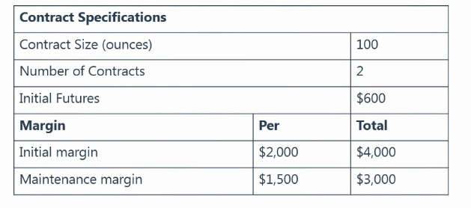
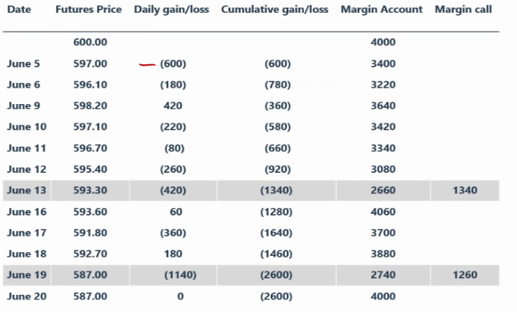
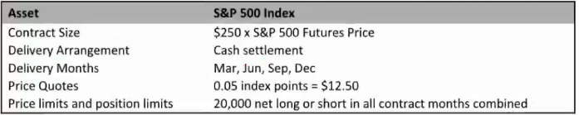
Asset Product
Futures
Standard contracts are defined by exchanges
The CCP of exchange becomes counterparty to all members
Underlying Asset: Temperature, Stock Index
Initial Margin: Needed, because it can protect CCP
Delivery: Mostly, people care about profits/ loss only
(Coke Cola will buy Sugar Futures from short party)
Positions can be closed out by CCP

Slide 17
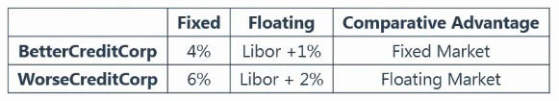
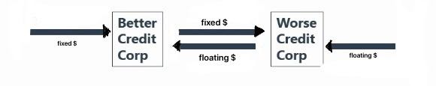
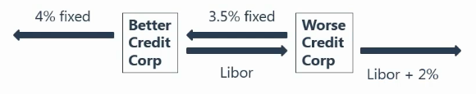
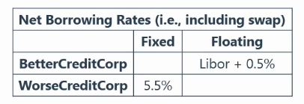
Asset Product
Swap
Comparative Advantage
Case Example: Better Credit Corporation want to borrow money at floating rate;
Worse Credit Corporation want to borrow money at fixed rate.
Cooperation !!
Cash Flow
Interest
Conclusion: Total benefit > 0

Slide 18



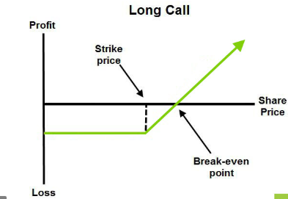
Asset Product
Option
Paying a premium for the right to buy (or sell) an asset at a future price.
Long/ Short; Call/ Put
An option to buy an asset at a particular price is termed a Call Option
An option to sell an asset at a particular price is termed a Put Option
The price specified in the contract is known as Strike Price

Slide 19


Thank You

